Slide 1
LoockMe: An Ever Evolving Artificial Intelligence Platform for Location Scouting in Greece
Eleftherios Trivizakis
PhD candidate
Computational BioMedicine Laboratory
Institute of Computer Science
Foundation for Research and Technology - Hellas

Slide 2
Presentation outline
Who are we?
Who funds this project?
Why develop such a platform?
Platform design
Datasets for NLP and DL imaging
Natural language processing
Deep learning image analysis
Challenges
Conclusions

Slide 3
Consortium
Computational BioMedicine Laboratory (ICS-FORTH)
Project leader
Heraklion, Crete
Ioannina, Epirus
Artificial Intelligence
Natural language processing
Deep Learning
Image analysis
HPC infrastructure
Conceptualization of the project
https://www.ics.forth.gr/cbml

Slide 4
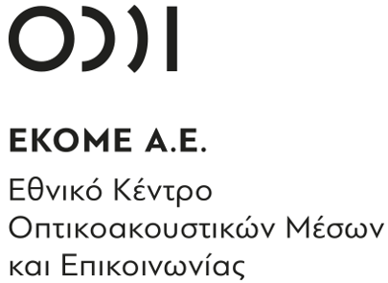
Consortium
National Center for Audiovisual Media and Communication (EKOME)
Public sector
Provides funding and support for foreign and domestic audiovisual productions
Whitefox
Private sector
Audiovisual productions
AppArt
Private sector
Front-end and platform development
DBC
Exploitation of research projects post funding
https://loockme.com/en/consortium/

Slide 5
Funding
Budget: 329.000 €
European Regional Development Fund
Greek Ministry of Economy and Development
EPAnEK 2014-2020
ESPA 2014-2020

Slide 6
Rational
Greek economy
Impact of films on tourism
“tourism- and shipping-based EU economy”
GDP – $209.79 billion
agriculture: 4.1% (2017 est.)
industry: 16.9% (2017 est.)
services: 79.1% (2017 est.)
Key industries
tourism, food and tobacco processing, textiles, chemicals, metal products; mining, petroleum
Labor force
agriculture: 12.6%
industry: 15%
services: 72.4%
“TUI Expects its Tourism Numbers in Greece to Grow Up to 13% in 2023”
“Greece's PM said … that revenues from its all-important tourism industry will reach at least 18 billion euros”
Perception: “…Greece (50.67%) with its cultural and historical sites…”
Wen et al. (DOI: 10.1016/j.tmp.2018.09.006)
“impacts of Captain Corelli's Mandolin on the Island of Cephalonia in Greece. The case supports previous research claiming that films can have a powerful influence on travel decisions.”
Hudson et al. (DOI: 10.1177/1356766706064619)
“On the Greek island of Mykonos, tourists can take a room at the Manoulas Beach Hotel, scene of the film Shirley Valentine.”, “50% increase over 3 years”
Hudson et al. (DOI: 10.1177/0047287506286720)
https://www.cia.gov/the-world-factbook/countries/greece/
https://www.oecd.org/economy/greece-economic-snapshot/
Notes:
Wen: Influence of movies and television on Chinese Tourists perception toward international tourism destinations
Hudson: Film tourism and destination marketing: The case of Captain Corelli's Mandolin
Hudson: Promoting destinations via film tourism: An empirical identification of supporting marketing initiatives

Slide 7
What LoockMe aspires to offer?
Functionality
Impact
Location services
Transport infrastructure
Accommodation
Weather
Other resources like electricity or water
Funding & tax break information
Baseline legal information
Required permits
Fees
Local talent
Scout locations without visiting different areas
Foreign and local audiovisual producers can access previously unknown locations
Individuals can make their property available
Local governments can share landmarks & locations
More opportunities for growth in local communities

Slide 8
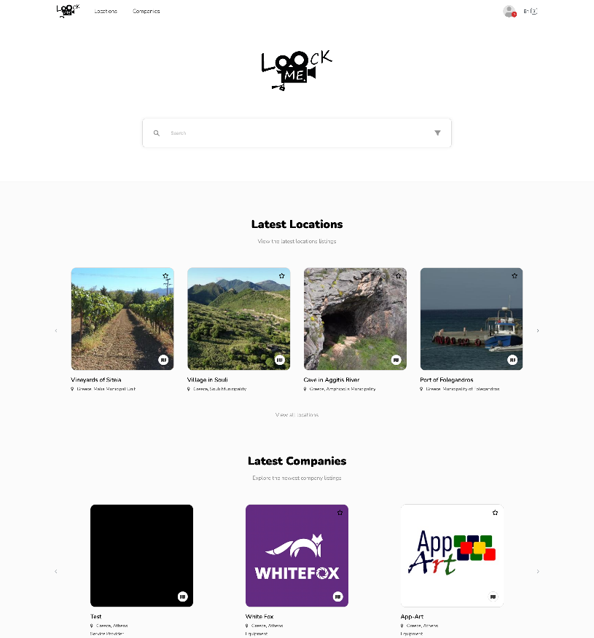
LoockMe platform – User Interface
Login page
Home page

Slide 9
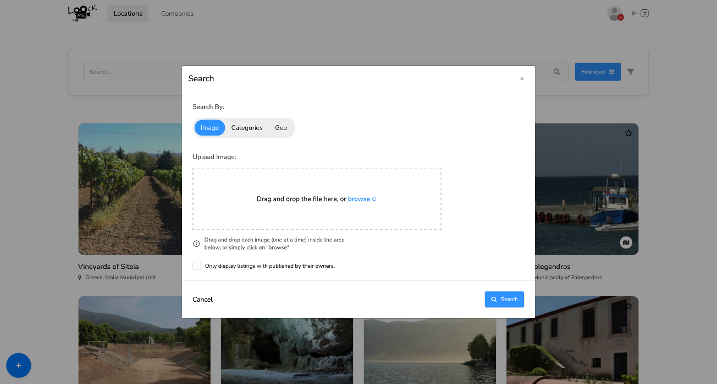
LoockMe platform – User Interface
Advanced search
Image search

Slide 10
Datasets
Natural language processing and imaging

Slide 11
Natural language processing
LoockMe dictionary for film terms
How it was obtained?
Scrape the best film offices for the most popular search terms
Consult the film and production experts of the consortium
Adapt the dictionary to the Greek landscape & culture
Identify a subgroup of terms for image analysis
Film offices
Domain experts
key words
film terms
imaging classes
NLP
LoockMe terms
smart
search
Front-end
Team: Aidonis V., Pezoulas V., Goletsis Y., Chondromatidou L.
Institute: FORTH Ioannina & Heraklion

Slide 12
Greek locations
Imaging data
The first version of the LoockMe dataset v0.5
Open-source image scraper
Copyright-free images
Greek locations
Categories
“ancient amphitheater” (164), “ancient temple” (171), “Byzantine architecture” (43), “Greek urban landscape” (29), “village (island)” (129), “old port” (39), “olive grove” (57), “ancient ruins” (33), “traditional Greek architecture” (23), “traditional stone bridge” (89), “vineyard” (136), “windmill” (107), “saltpan” (18)
All images were resized to 256 by 256 pixels
The dataset consists of 1038 samples across 13 categories.
Team: Oikonomou N., Trivizakis E.
Institute: FORTH Heraklion

Slide 13
Platform design
From the user to the AI infrastructure

Slide 14
Main AI concept
Inspiration
LoockMe AI – combine text & image
1. Deng, Jia, et al. "Imagenet: A large-scale hierarchical image database." 2009 IEEE conference on computer vision and pattern recognition. Ieee, 2009.
2. Zhou, Bolei, et al. "Places: A 10 million image database for scene recognition." IEEE transactions on pattern analysis and machine intelligence 40.6 (2017): 1452-1464.
3. Krishna, Ranjay, et al. "Visual genome: Connecting language and vision using crowdsourced dense image annotations." International journal of computer vision 123 (2017): 32-73.

Slide 15
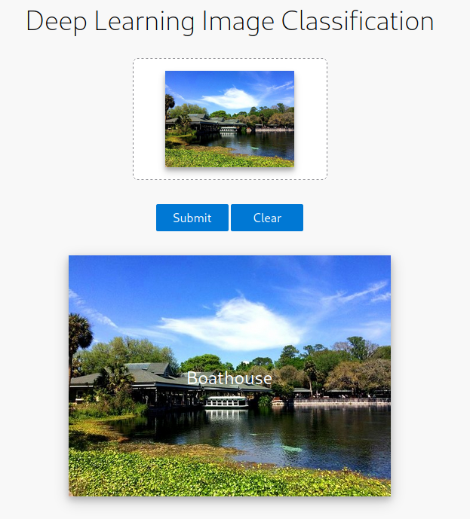
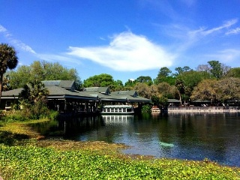
LoockMe platform use cases
Free text-based search
Deep learning-based analysis
input image
“boathouse”

Slide 16
LoockMe platform usability scenarios
Free text-based search
Docker Container
dl
cv
Images db
web
flask
owl
rest
client side

Slide 17
LoockMe platform usability scenarios
Deep learning-based analysis
Docker Container
dl
cv
images db
web
flask
owl
“boathouse”
rest
client side

Slide 18
Natural language processing
The backbone of LoockMe

Slide 19
Natural language processing
Relevant general categories & search terms
Aim of NLP module
Establish the LoockMe dictionary
Smart search
Match search terms to the available LoockMe terms
Identify the context of a search query
Return the most relevant results
Adapt to future changes & data drift
Team: Aidonis V., Pezoulas V., Goletsis Y.
Institute: FORTH Ioannina
Notes:
The content provider or end-user writes a description/sentence.
1. The service receives an API request.
2. The NLP pipeline processes the request.
3. The service returns an API response.
Preprocessing:
1. The function takes a string of words as input and converts them to lowercase, while
also handling capital letters and dashes (-, _).
2. It uses the word_tokenize() function from the NLTK library to remove all punctuation
from the input.
3. It splits the resulting string into a list of unique words.
4. It lemmatizes the words in the list using the WordNetLemmatizer class from the
nltk.stem package.
5. It removes all stopwords from the list using the stopword corpus from the nltk.copus
package.
NLP analysis:
The first process (a) uses the set of words proposed by the user to find embeddings.
• The second process (b) uses the set of all nouns found in the user’s input.
• The third process (c) uses themain part of the sentence that comes before determiners,
adverbs, or subordinating conjunctions, if they exist.
The overall effectiveness of the NLP service on the validation sets have a total of 88% accuracy.

Slide 20
Deep learning image analysis
The impact of transfer learning

Slide 21
Transfer learning
The convolutional weights were transferred to the new target LoockMe model
Methodology
Weights from the convolutional part
Multiple architectures (Keras)
VGG
Inception
Xception
ResNet
MobileNet
DenseNet
Frozen weights except a few higher-level layers
New neural network (256, 512, 1024)
New classification layer
Best practices in data science
All the LoockMe models are available online
Team: Trivizakis E.
Institute: FORTH Heraklion

Slide 22
Performance analysis
Best versus worst models
Best model
DenseNet + 512 neurons
242 layers
ACC: 90.3±0.7
Successfully categorizes even classes with very few samples
Worst model
ResNet + 256 neurons
107 layers
ACC: 68.8±1.5
Completely fails in many classes
Notes:
AUC 99.4
Classes that completely fail in ResNet:
-“Greek urban landscape” is miscategorized as “Byzantine architecture” and “village
(island)”. This is because the background in some samples of “Byzantine architecture” is
often a Greek city, for instance when a church is depicted.
-”ancient ruins” are classified as “ancient amphitheater”
-”Traditional Greek architecture”, which mostly consists of old stone buildings, as “ancient ruins” or “village (island)”.

Slide 23
Assessing the fitting status
Learning curves best versus worst model
DenseNet
8 million parameters
Validation loss 0.27
Good fit, but there is room for improvement
A more diverse dataset will further reduce the error
ResNet
>25 million parameters
Very high validation loss
Poorly fitted model

Slide 24
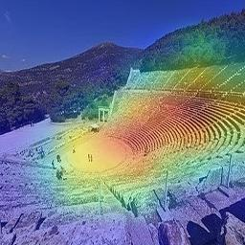
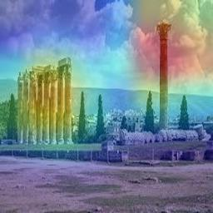
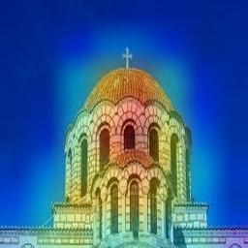
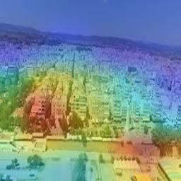
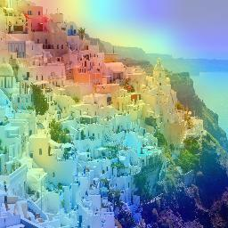
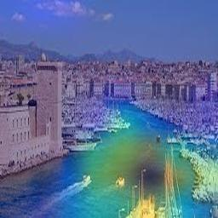
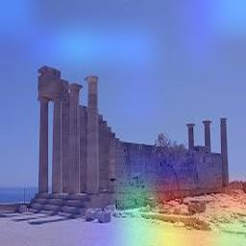
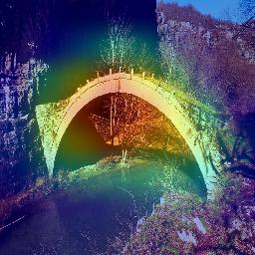
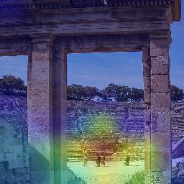
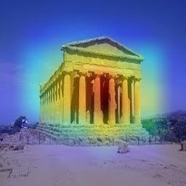
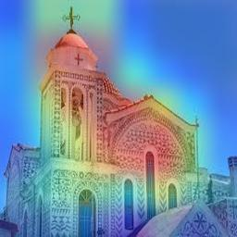
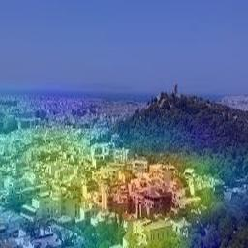
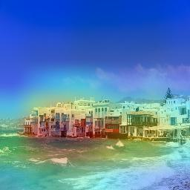
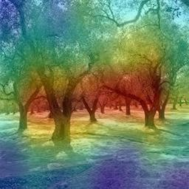
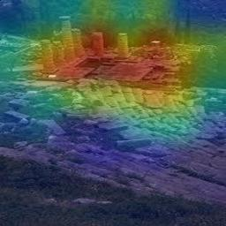
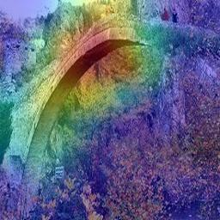
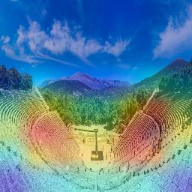
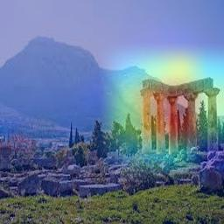
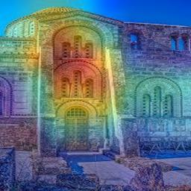
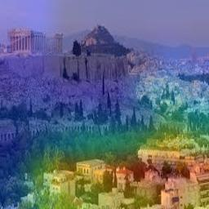
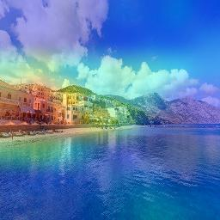
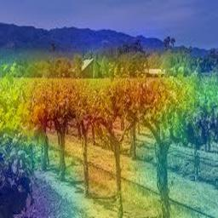
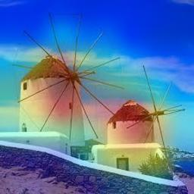
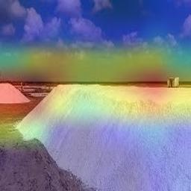
Interpretability of the LoockMe models
amphitheater
temple
Byzantine
Greek urban
village (island)
port
ruins
stone bridge
Olive grove
vineyard
windmill
saltpan

Slide 25
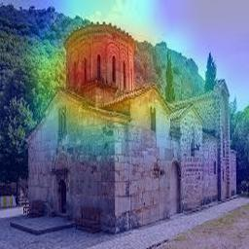
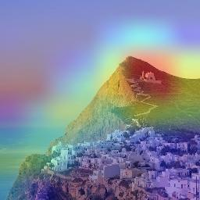
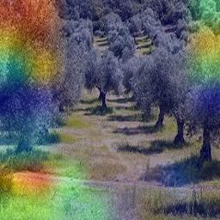
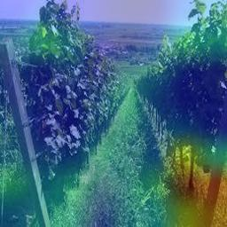
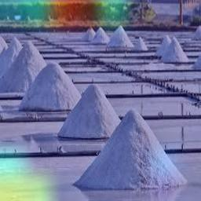
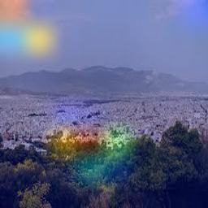
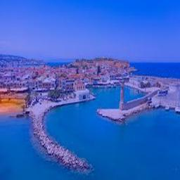
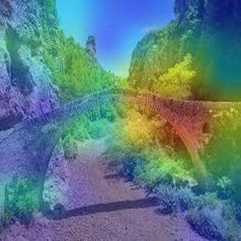
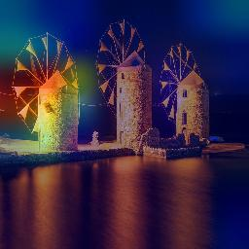
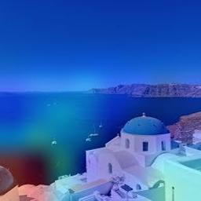
Less than perfect… attention!
https://github.com/trivizakis/loockme-model/

Slide 26
Challenges
Spoiler alert: It’s data collection!

Slide 27
Common errors during annotation and labeling
Cave
Cave
Stone Bridge
Olive Grove
Ancient Temple
Lake
Church
Church

Slide 28
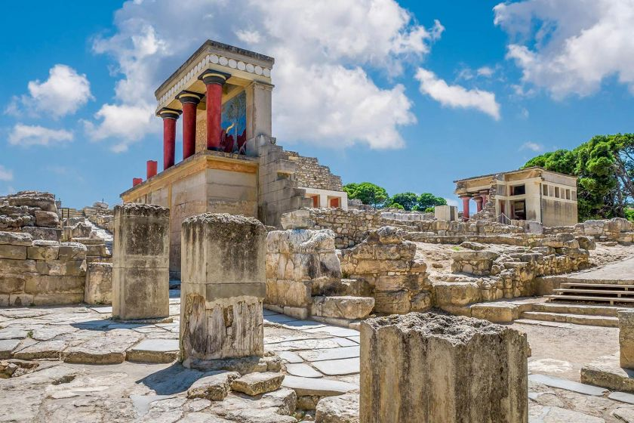
More errors!
Administrative Building
Object boarders
Missing multiple objects

Slide 29
Closing remarks
Current state of the LoockMe platform
(Near) Future extensions
Testing phase
Usability
Accessibility
Debugging
Evaluation by experts
Extend functionality
Deploy the latest AI models
Local governments and film offices
Market the platform at relevant events
Deep learning detection
Image-to-Image search
NLP for short descriptions
Expand dataset
Diversity
More categories
More samples
Bounding boxes
Models will adapt to new data
Notes:
Current LoockMe Dataset v3 198 classes
>3000 images >4000 bounding boxes

